Slide 1
Planetary Wind & Moisture Belts in the Troposphere (Annotated Version)
By Zach Miller, John Jay Middle School, Cross River, NY.
Above wind vector animation from http://hint.fm/wind/.
(Hurricane Isaac is visible in this animation making landfall on the Louisiana
coastline on August 29, 2012.)
All background images in the following presentation are adapted from New York State Earth Science Reference Tables (2011 Edition, p. 14).
Other credits and related wind resources are HERE.

Slide 2
Convection & Moisture Belts: Part 1
What causes air to move?
&
How does air movement create moisture belts?

Slide 3
Convection & Moisture Belts

Slide 4
Convection & Moisture Belts

Slide 5
Convection & Moisture Belts
Area of Interest.
Let us focus on an observer at the equator & rotate the diagram 90° counter-clockwise.

Slide 6
Convection & Moisture Belts
Atmospheric Characteristics at the Equator (0° latitude):
Warm air has high potential evapotranspiration.
This leads to air masses having high moisture content from various sources: surface water (oceans, lakes, streams), soil moisture, and plants.
Therefore, maritime tropical (“mT”) often dominates this area.

Slide 7
Convection & Moisture Belts
Behavior of warm moist air at the equator:
Warm air is less dense compared to cool air.
Cold air moves underneath warm air – warm air rises as it’s lifted by relatively cold dense air moving in beneath it.

Slide 8
Convection & Moisture Belts
Behavior of warm moist air at the equator:
Warm air is less dense compared to cool air.
Cold air moves underneath warm air – warm air rises as it’s lifted by relatively cold dense air moving in beneath it.

Slide 9
Convection & Moisture Belts
Behavior of warm moist air at the equator:
Warm air is less dense compared to cool air.
Cold air moves underneath warm air – warm air rises as it’s lifted by relatively cold dense air moving in beneath it.

Slide 10
Convection & Moisture Belts
The model below is simplified, as it lacks gradual changes in air temperature and resulting precipitation patterns.
Continue for further details…

Slide 11
Convection & Moisture Belts
Let’s start by examining the warm moist air rising vertically in the atmosphere.
What happens to the mT air mass as it rises?

Slide 12
Convection & Moisture Belts
Refer to your Earth Science Reference Tables atmosphere layers diagram on p. 14 (see diagram below).
Find the term “troposphere”.

Slide 13
Convection & Moisture Belts
Air pressure decreases as the parcel (area) of warm moist (mT) air rises through the atmosphere.
Air expands as air pressure decreases.
Air cools as it expands.
We will update our model to reflect this process.

Slide 14
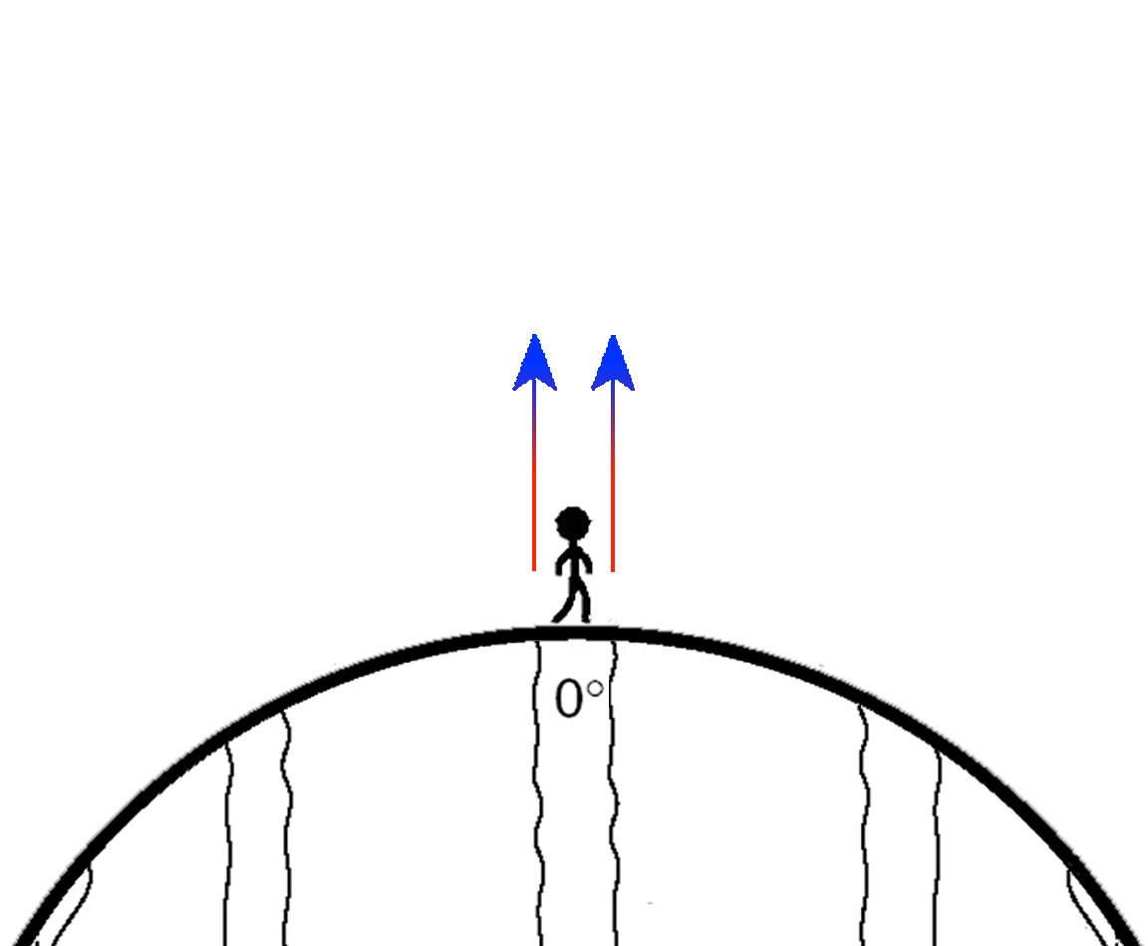
Convection & Moisture Belts
The diagram below will now reflect this gradual decrease in temperature as altitude increases.

Slide 15
Convection & Moisture Belts
To review:
Warm moist (mT) air rises due to colder denser air moving underneath it.
The warm air cools as it rises to higher altitudes in the atmosphere.
Cold Air
Warm Air

Slide 16
Convection & Moisture Belts
How does the cooling of warm moist air relate to precipitation?

Slide 17
Convection & Moisture Belts
Air must be saturated with water vapor for precipitation to occur.
Air is often saturated by water vapor due to the air temperature falling to (or below) the dewpoint temperature.*
*The dewpoint temperature can vary independent of the air temperature, although it is common – as in this case – for the temperature to fall to (or below) the dewpoint temperature for
saturation to
occur.

Slide 18
Convection & Moisture Belts
Warm moist air rises.
The air expands and cools.
Cooling triggers condensation.
Continued cooling and condensation causes precipitation.

Slide 19
Convection & Moisture Belts
The cold dense air at higher altitudes has only one “escape route” – to diverge (spread out) and descend (sink) back toward earth’s surface.

Slide 20
Convection & Moisture Belts
The cold dense air at higher altitudes has only one “escape route” – to diverge (spread out) and descend (sink) back toward earth’s surface.

Slide 21
Convection & Moisture Belts
As the air descends toward earth’s surface it warms due to the increase in atmospheric pressure.
The sinking air is drier compared to the air originating at the equator.

Slide 22
Convection & Moisture Belts
As the air descends toward earth’s surface it warms due to the increase in atmospheric pressure.
Much of the air converges toward the equator – it will be “rejuvenated” gaining moisture and warming on its journey.

Slide 23
Convection & Moisture Belts
The cycle is complete as the air arrives at the equator to eventually rise again.
We’ll now watch the entire process looped in an animation…

Slide 24
Convection & Moisture Belts
The entire process is a classic example of “convection” – the transfer of heat by movement of air or a liquid.*
*Note that moisture transfer is not a requirement for convection to occur, although it is important within meteorology.

Slide 25
Convection & Moisture Belts
The convection shown below can also be referred to as two somewhat independent convection cells.
1
2

Slide 26
Convection & Moisture Belts
The bottom “leg” of a convection current is Wind:
the movement of air – parallel to earth’s surface – due to differences in density
*Uneven heating of the earth causes these temperature and density variations.

Slide 27
Convection & Moisture Belts
The convection cell model shown below (focusing on the equator) can be rotated and viewed on a global scale…

Slide 28
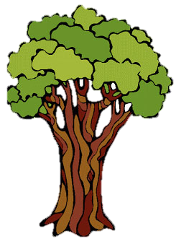
Convection & Moisture Belts
It also explains why the world’s major rainforests are located along the equator.
This is why the equator is generally a warm wet location.

Slide 29
Convection & Moisture Belts
It also explains why the world’s major rainforests are located along the equator.
This is why the equator is generally a warm wet location.
Note that this generalized climate information is noted here for you.

Slide 30
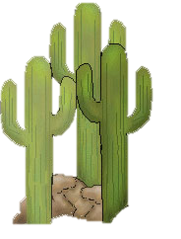
Convection & Moisture Belts
The dry descending air at 30° North and South Latitude explains large desert regions found along this latitude belt.

Slide 31
Convection & Moisture Belts
Again, note that this generalized climate information is noted here for you.
The dry descending air at 30° North and South Latitude explains large desert regions found along this latitude belt.

Slide 32
Convection & Moisture Belts
Note that the separation between climate belts is fairly consistent on earth.
These divisions of 30° Latitude is also noted here for you.
Again, note that this generalized climate information is noted here for you.
The dry descending air at 30° North and South Latitude explains large desert regions found along this latitude belt.

Slide 33
Convection & Moisture Belts
The pattern of convection cells at 30° Latitude intervals continues…

Slide 34
Convection & Moisture Belts
The pattern of convection cells at 30° Latitude intervals continues…

Slide 35
Convection & Moisture Belts
The pattern of convection cells at 30° Latitude intervals continues…

Slide 36
Convection & Moisture Belts
The pattern of convection cells at 30° Latitude intervals continues…

Slide 37
Convection & Moisture Belts
Let us complete the convection cell pattern.

Slide 38
Convection & Moisture Belts
Let us complete the convection cell pattern.

Slide 39
Convection & Moisture Belts
The alternating wet/dry climate belts also continue at 30° intervals.

Slide 40
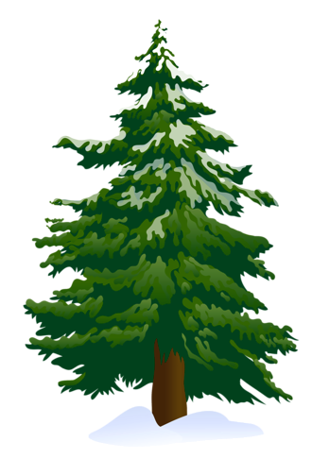
Convection & Moisture Belts
The alternating wet/dry climate belts also continue at 30° intervals.
Creating evergreen forests at
60° North and South Latitude.

Slide 41
Convection & Moisture Belts
The alternating wet/dry climate belts also continue at 30° intervals.
Creating evergreen forests at
60° North and South Latitude.
And, dry conditions at polar regions.

Slide 42
Convection & Moisture Belts
Lastly, note the climate and latitude
polar region information is also noted for you.

Slide 43
Convection & Moisture Belts
Like all models, there are flaws, or drawbacks, worth pointing out.
For example, average global air temperatures (at or near sea level) vary greatly at equatorial regions compared to polar regions.

Slide 44
Convection & Moisture Belts
Therefore, keep in mind that the model shown here emphasizes temperature changes within each respective convection cell.
A model showing temperature variations by latitude would look very different…

Slide 45
Convection & Moisture Belts
As shown here.
What is missing from this model that is fundamental in “driving” convection?
Therefore, to support understanding of convection and climate belts, a model with temperature changes within convection cells may be best visually.

Slide 46
Convection & Moisture Belts
Be aware that the model so far is only showing southerly winds (winds blowing from the south),
and northerly winds (winds blowing from the north).
Further discussion is needed on this point.

Slide 47
Convection & Moisture Belts
Keep in mind your reference tables do not contain details on temperature or precipitation as shown in this presentation – at least not directly.
For example, the “Planetary Wind & Moisture Belts…” diagram shows the following for convection and climate belts.

Slide 48
Convection & Moisture Belts
The deeper process understanding of this diagram is up to you! ☺

Slide 49
Convection & Moisture Belts: Part 2 (under construction…)
What causes air to deflect?
Why is the earth not made up of north and south winds only?

Slide 50
Convection & Moisture Belts
We had left off with convection
currents.
We’ll now focus on surface level
Winds...
…By looking first at winds near the equator.

Slide 51
Convection & Moisture Belts

Slide 52
Convection & Moisture Belts
Convection of generalized planetary winds within 30° of the equator is
shown here.
Note the winds near sea level only blow toward the equator in this example.
We’ll start by
focusing on these
equatorial surface level northerly and southerly winds...

Slide 53
Convection & Moisture Belts
We had left off here with convection currents.
This column of air is characterized by warm dense air.
Warm air weighs less for a given volume of air compared to cold air.
This causes an area of lower atmospheric pressure along the equator.

Slide 54
Teacher Notes
Credits:
http://epsc.wustl.edu/courses/epsc105a/files2/Animations_7/GlobalWind.html (convection animation within this presentation)
Other wind resources:
http://earth.nullschool.net
http://geog.uoregon.edu/envchange/clim_animations/
Click HERE to return to the start of this presentation.

